Slide 1


Project - II (3360707)
GST BILL GENERATOR
Prepared By:
Harsh N. Shah (196620307059)
Udit K. Parekh (196620307043)
Diploma Computer Engineering
Darshan Institute of Engg. & Tech. for Diploma Studies, Rajkot.
Guided By:
Prof. Bhavesh K. Chhatrala
Computer Engineering Dept.,
Darshan Institute of Engg. & Tech. for Diploma Studies, Rajkot.

Slide 2
Abstract
When we want to generate the bill for the purchased products, it takes lots of time to calculate bill amount and there may chances of mistake in calculation. In case of mistake in calculate, it leads to wastage of paper and time. So, we have developed Android Application “GST Bill Generator” will generate the bill in PDF format very easily. In application we have to just add customer details first time, add list of products purchased by the customer and it will generate a bill quickly. This application has functionalities to save generated bill for future use, user can view previously purchased product details of the customer etc. So, it saves our precious time and environment.

Slide 3
Problem Summary
Problem Identification :
When we want to generate the bill for the purchased products, it takes lots of time to calculate bill amount and there may chances of mistake in calculation. In case of mistake in calculate, it leads to wastage of paper and time. It is also difficult to maintain hard copy of the bills for user/shopkeeper.

Slide 4
Problem Summary (conti…)
Problem Solution :
The solution for above mentioned problem, we have developed Android Application “GST Bill Generator” will generate the bill in PDF format very easily. In application we have to just add customer details first time, add list of products purchased by the customer and it will generate a bill. This application has functionalities to save generated bill for future use, user can view previously purchased product details of the customer etc. So, it saves our precious time, environment and cost effectively.

Slide 5
Module Description
Customer :
The details of customer have been stored in this module. User can insert detail about their customer such as Customer Name, City and Contact Number etc.
CustomerID : ID of customer.
CustomerName : Name of customer.
ContactNumber : Contact number of customer.
City : City of customer.
CreatedDate : Date when customer added.

Slide 6
Module Description (conti…)
Product :
In this module, the details of product have been stored. User can view product detail like Product Name, GST Percent, Price etc.
ProductID : ID of product.
ProductName : Name of product.
ProductGSTPercent : GST percent of product.
ProductPrice : Price of product.
ProductQuantity : Quantity of product.

Slide 7
Module Description (conti…)
Purchase :
In this module, the details of purchased product have been stored. User can insert and delete purchased product. User can insert product details like Product Name, GST Percent, Purchase Quantity, Total Price etc.
PurchaseID : ID of purchase.
ProductID : ID of product.
CustomerID : ID of customer.
PurchasedQuantity : Quantity of purchase.
TotalPrice : Total price of purchase.

Slide 8
Module Description (conti…)
Bill :
In this module, After purchase products by the customer, Bill will be generated and save all details for future use. Bill contains details like Customer Name, Product Name, Product GST Percent, Purchased Quantity, Total Price of Bill etc.
BillID : ID of bill.
PurchaseID : ID of purchase.
CustomerID : ID of customer.
TotalBill : Total bill amount to be pay
BillDate : Date of bill created
IsPaid : Is bill paid or not

Slide 9
Module Description (conti…)
History :
In this module, the past purchase details of the customers will be stored. User can view & download previously generated bill. Bill contains details like Customer Name, Product Name, Product GST Percent, Purchased Quantity, Total Price of Bill etc.
HistoryID : ID of history.
CustomerID : ID of customer.
PurchaseID : ID of purchase.
BillID : ID of generated bill.

Slide 10
Data Dictionary
INS_CustomerDetail
Field Name | Data Type | Size | Constraint | Reference
CustomerID | integer | 10 | PK | -
CustomerName | varchar | 50 | Not Null | -
ContactNumber | integer | 20 | Not Null | -
CreatedDate | datetime | 50 | Not Null | -
City | varchar | 30 | Not Null | -
Remarks | varchar | 100 | - | -

Slide 11
Data Dictionary (conti…)
MST_ProductDetail
Field Name | Data Type | Size | Constraint | Reference
ProductID | integer | 10 | PK | -
ProductName | varchar | 50 | Not Null | -
ProductGSTPercent | integer | 10 | Not Null | -
ProductPrice | integer | 10 | Not Null | -
ProductQuantity | integer | 10 | Not Null | -
Remarks | varchar | 100 | - | -

Slide 12
Data Dictionary (conti…)
INS_HistoryDetail
Field Name | Data Type | Size | Constraint | Reference
HistoryID | integer | 10 | PK | -
CustomerID | integer | 10 | FK | INS_CustomerDetail
PurchaseID | integer | 10 | FK | INS_PurchaseDetail
BillID | integer | 10 | FK | INS_BillGenerate
Remarks | varchar | 100 | - | -

Slide 13
Data Dictionary (conti…)
INS_PurchaseDetail
Field Name | Data Type | Size | Constraint | Reference
PurchaseID | integer | 10 | PK | -
CustomerID | integer | 10 | FK | INS_CustomerDetail
ProductID | integer | 10 | FK | MST_ProductDetail
PurchasedQuantity | integer | 10 | Not Null | -
TotalPrice | integer | 10 | Not Null | -
Remarks | varchar | 100 | - | -

Slide 14
Data Dictionary (conti…)
TRN_BillGenerate
Field Name | Data Type | Size | Constraint | Reference
BillID | integer | 10 | PK | -
PurchaseID | integer | 10 | FK | INS_PurchaseDetail
CustomerID | integer | 10 | FK | INS_CustomerDetail
TotalBill | integer | 10 | Not Null | -
BillDate | datetime | 50 | Not Null | -
IsPaid | integer | 10 | Not Null | -
Remarks | varchar | 30 | -

Slide 15
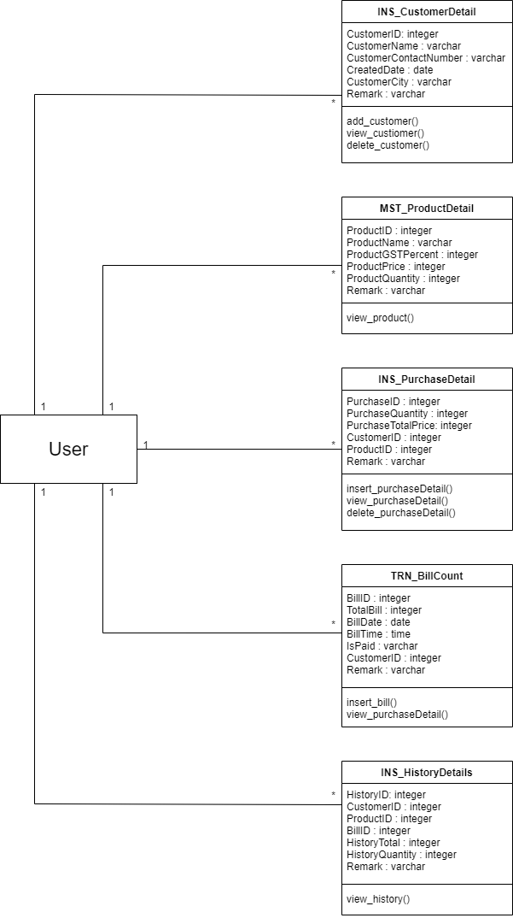
Diagrams
CLASS DIAGRAM
Fig 7.1

Slide 16
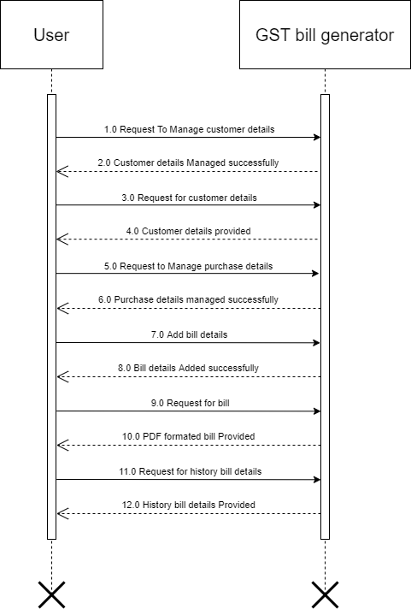
Diagrams (conti…)
SEQUENCE DIAGRAM
Fig 7.2

Slide 17
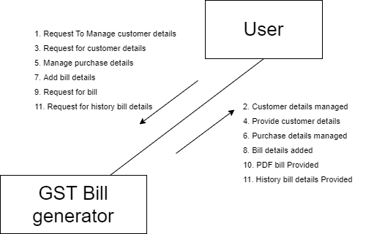
Diagrams (conti…)
COLLABORATION DIAGRAM
Fig 7.3

Slide 18
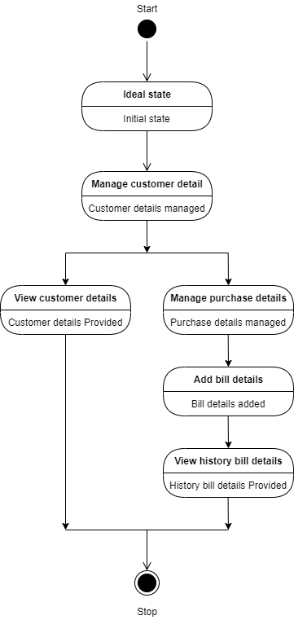
Diagrams (conti…)
STATE DIAGRAM
Fig 7.4

Slide 19
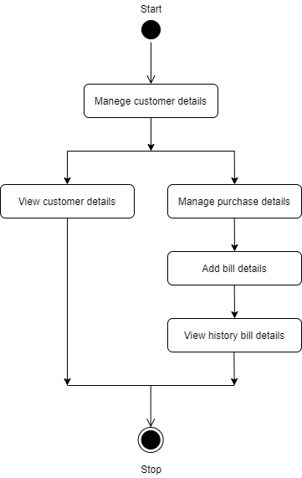
Diagrams (conti…)
ACTIVITY DIAGRAM
Fig 7.5

Slide 20
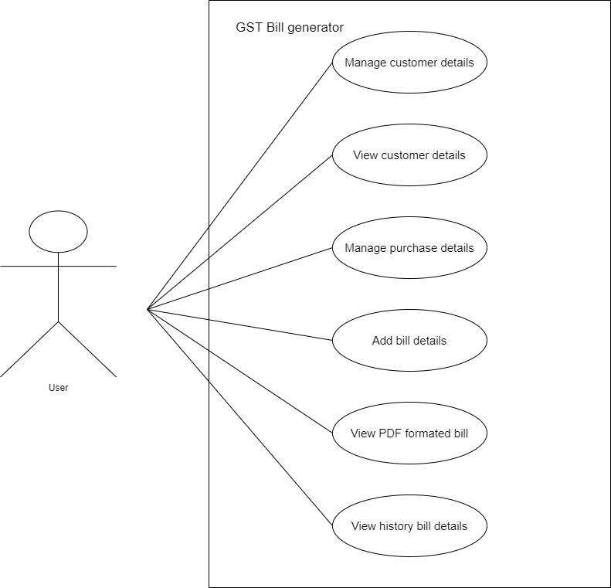
Diagrams (conti…)
USE CASE DIAGRAM
Fig 7.6

Slide 21
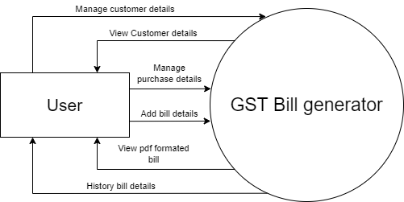
Diagrams (conti…)
DATAFLOW DIAGRAM(LEVEL 0)
Fig 7.7.1

Slide 22
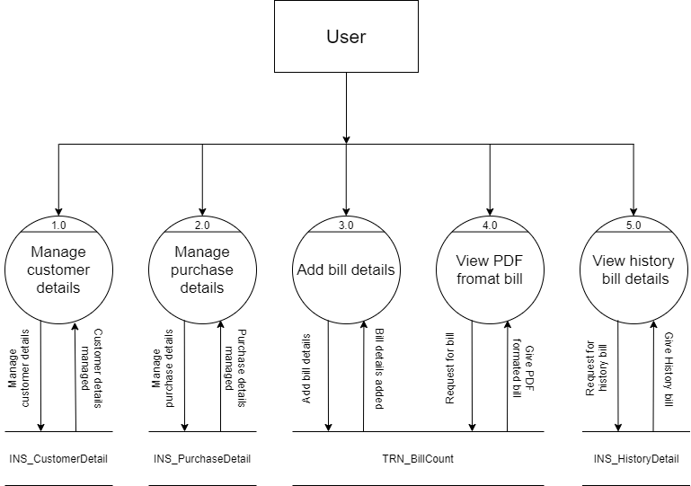
Diagrams (conti…)
DATAFLOW DIAGRAM(LEVEL 1)
Fig 7.7.2

Slide 23
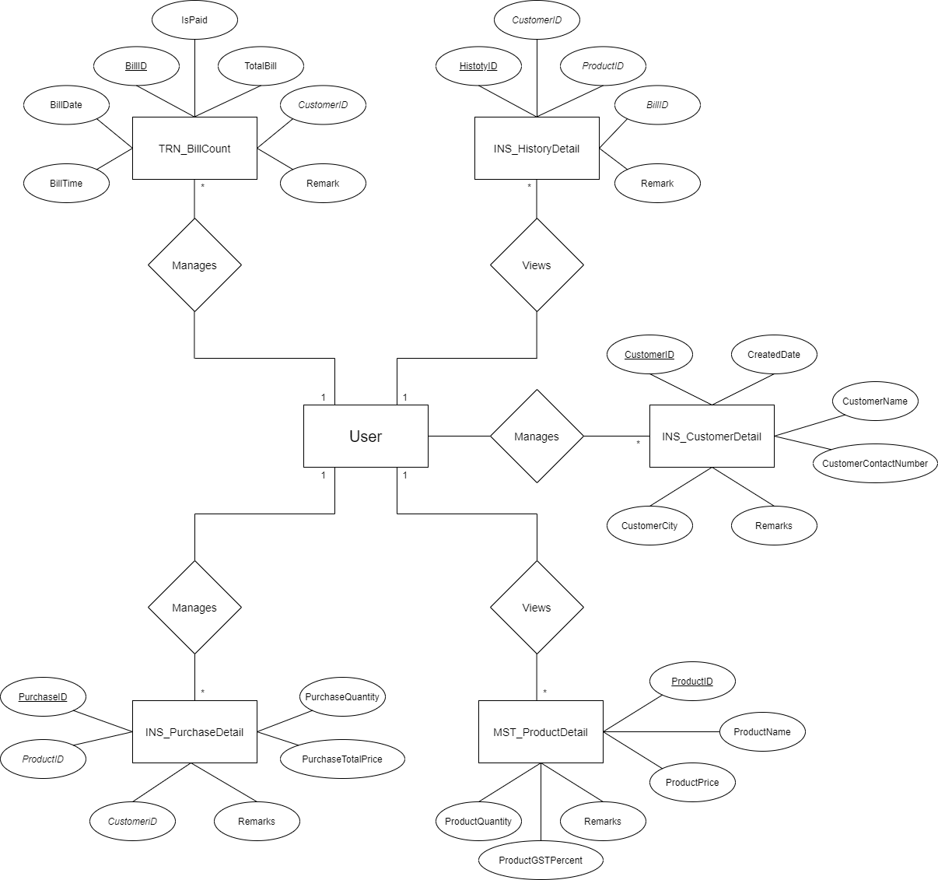
Diagrams (conti…)
E-R DIAGRAM
Fig 7.8

Slide 24
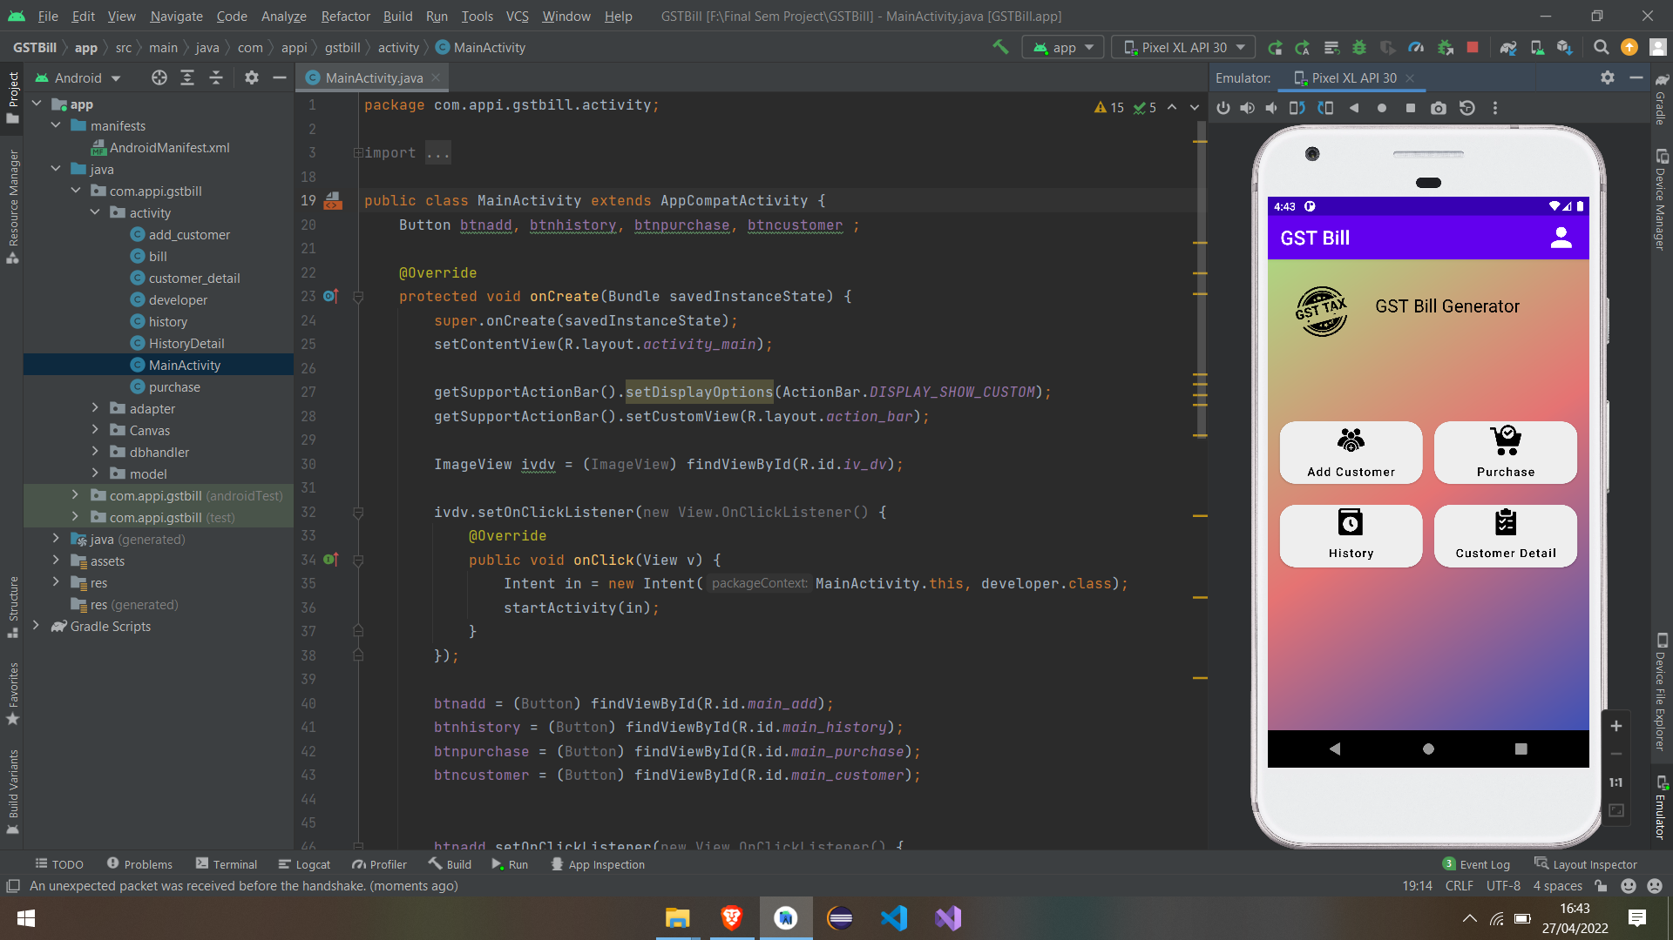
Screenshots
Dashboard
Fig 8.1

Slide 25
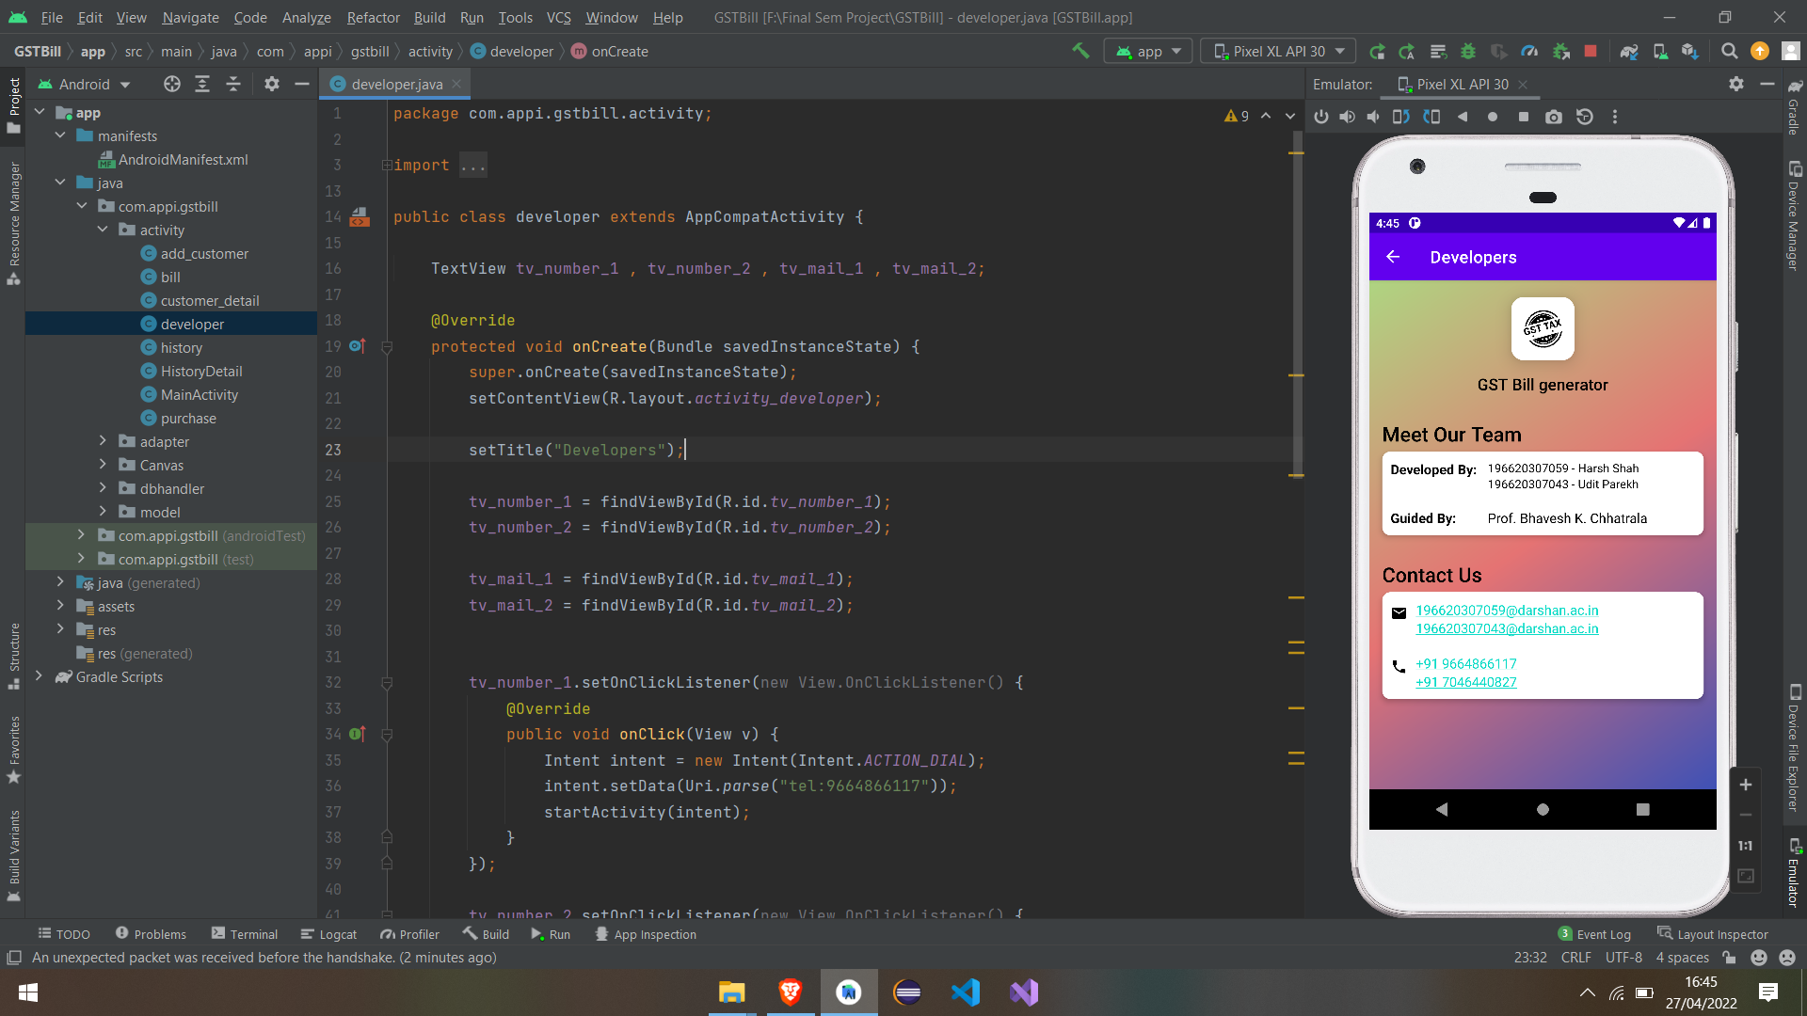
Screenshots (conti…)
Developer
Fig 8.2

Slide 26
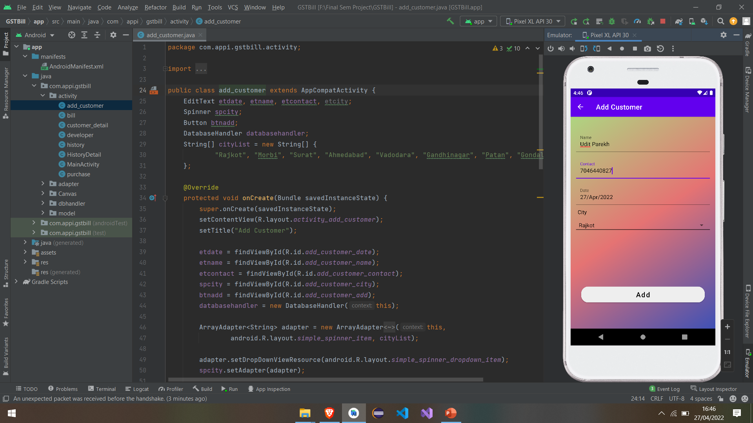
Screenshots (conti…)
Add Customer
Fig 8.3

Slide 27
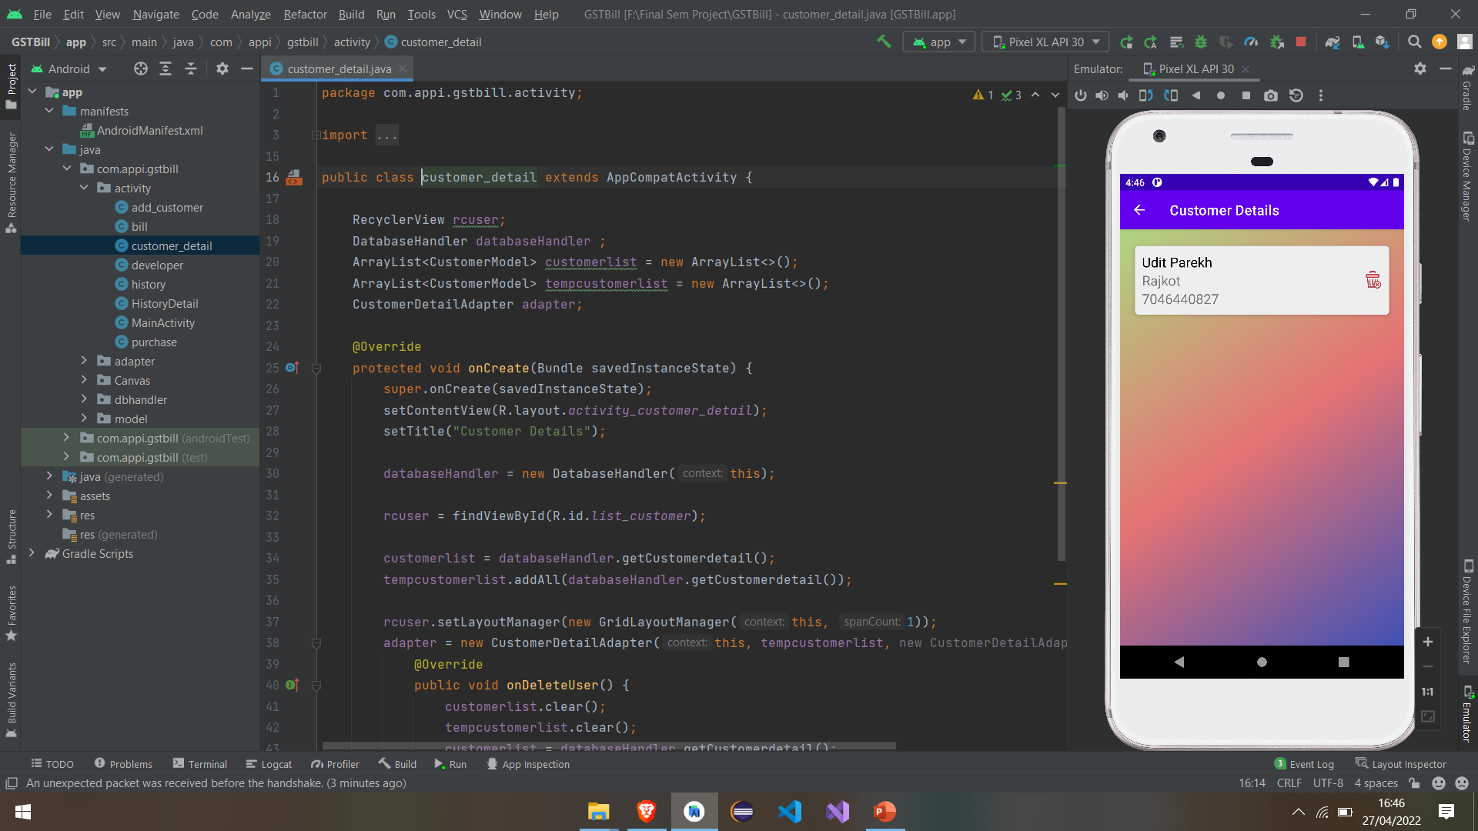
Screenshots (conti…)
Customer Details
Fig 8.4

Slide 28
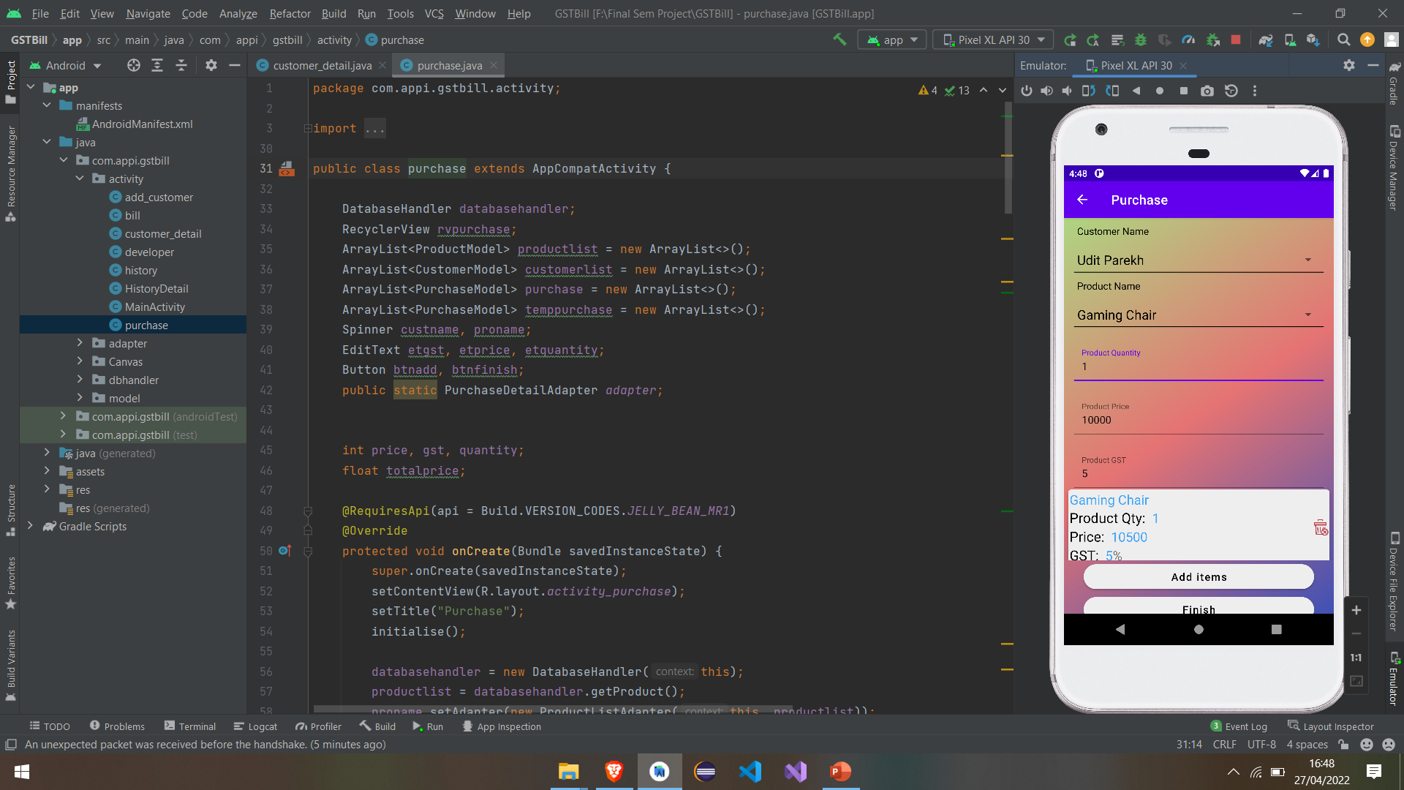
Screenshots (conti…)
Purchase
Fig 8.5

Slide 29
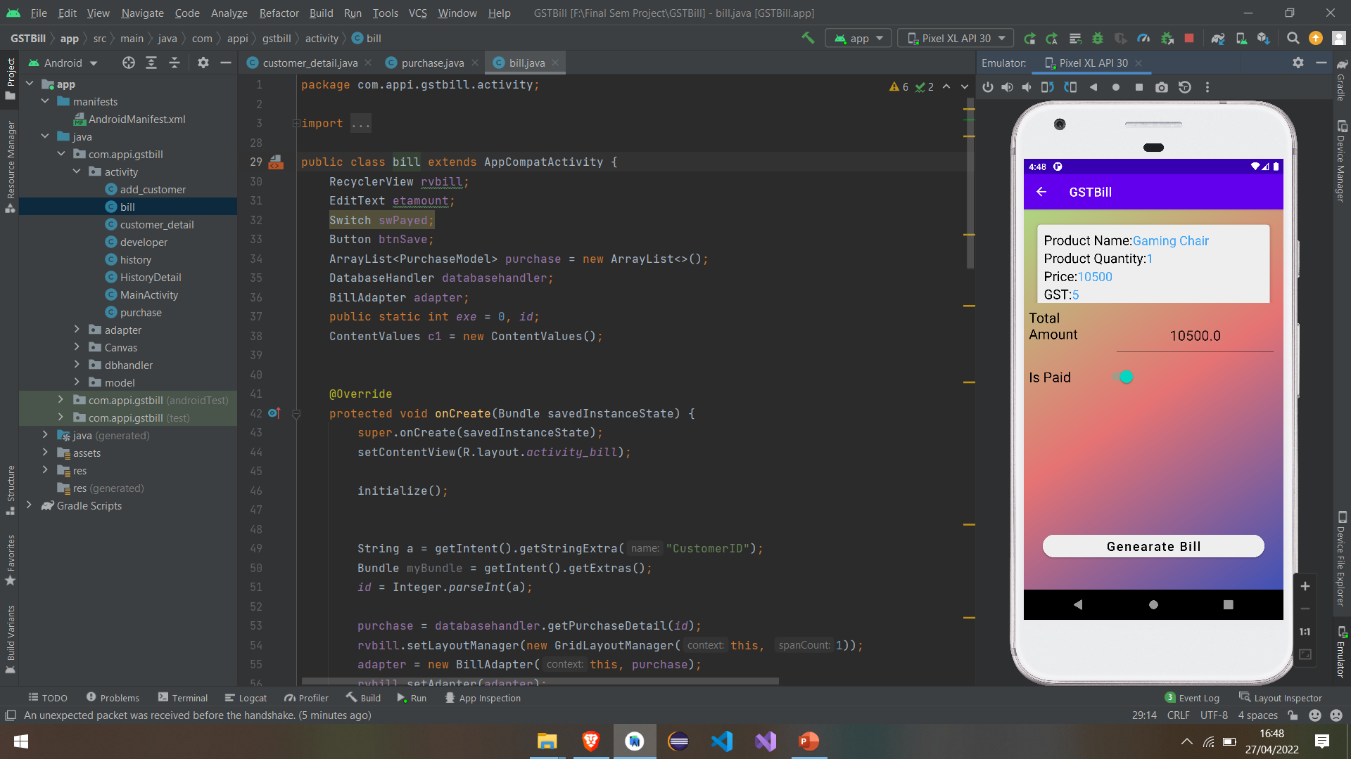
Screenshots (conti…)
Display Bill
Fig 8.6

Slide 30
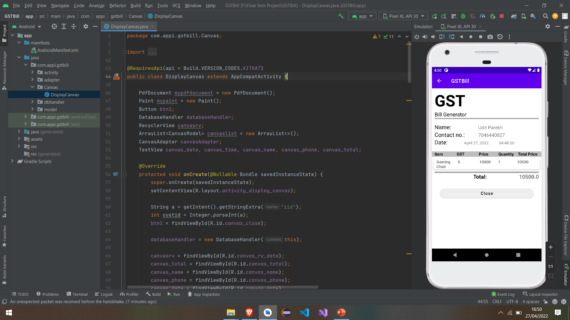
Screenshots (conti…)
Bill Generate
Fig 8.7

Slide 31
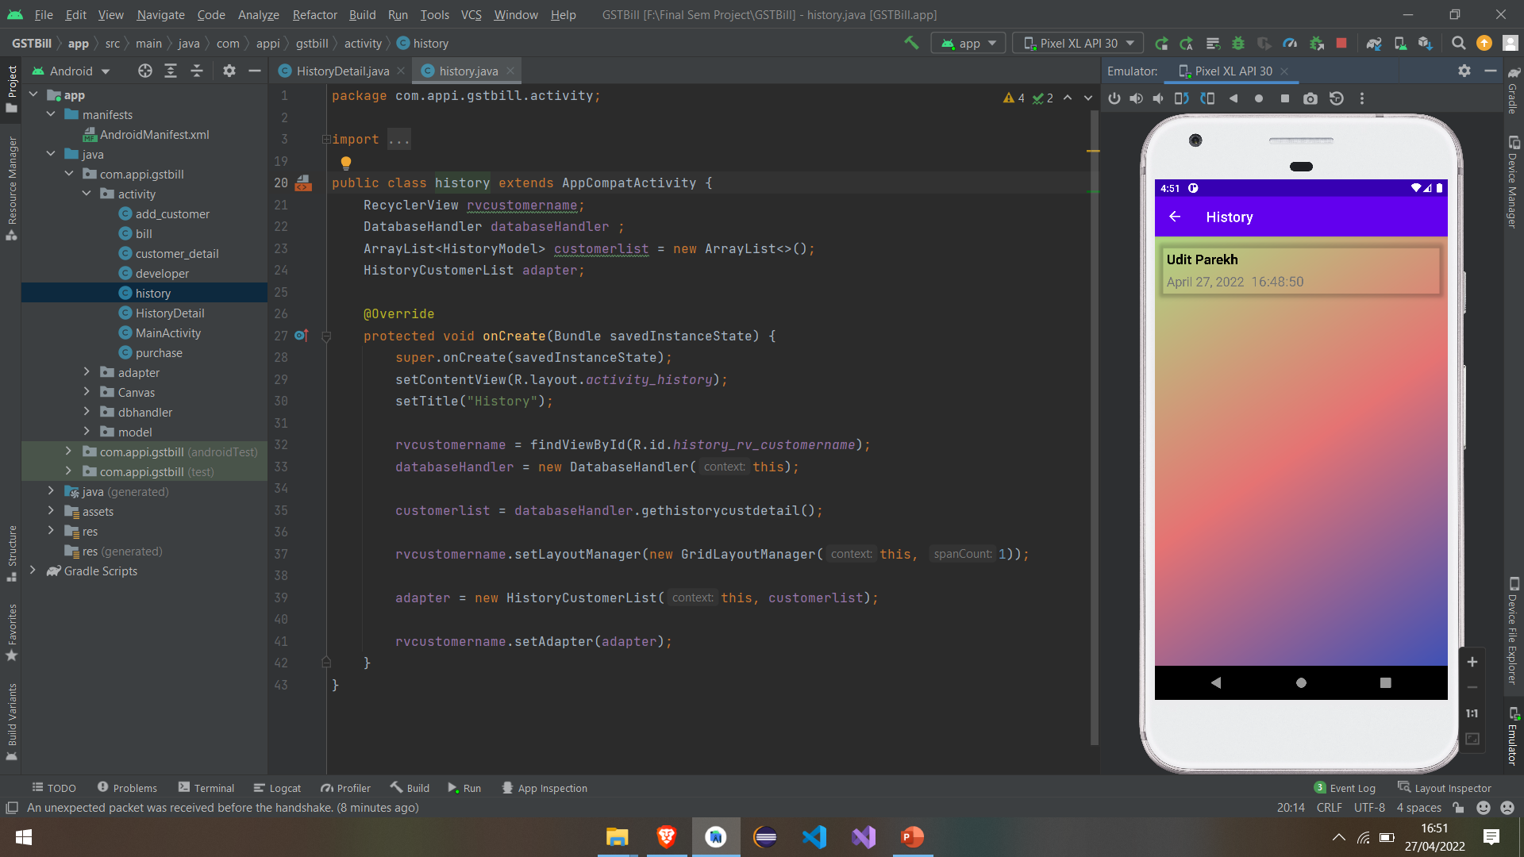
Screenshots (conti…)
History
Fig 8.8

Slide 32
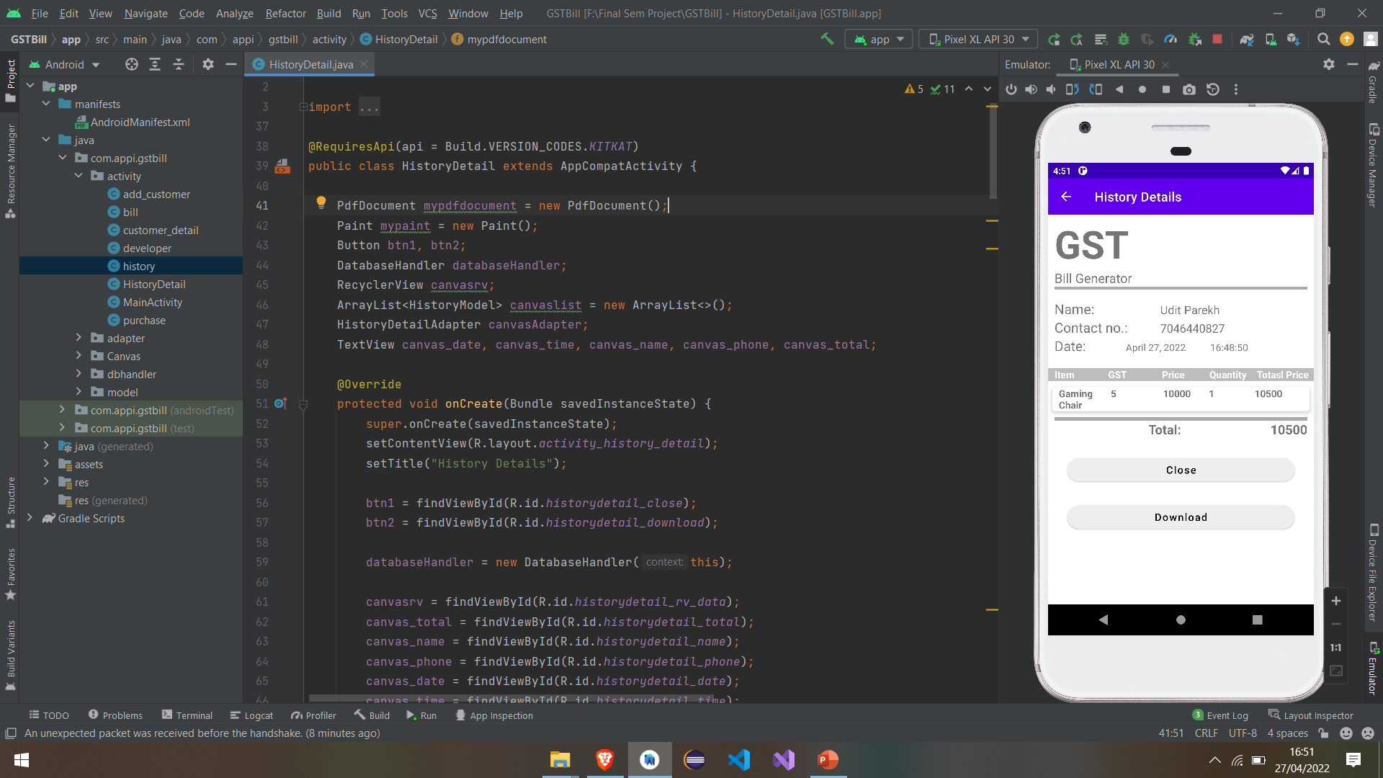
Screenshots (conti…)
Saved Bill As PDF
Fig 8.9

Slide 33
Conclusion
Users will able to generate the bill easily by using “GST Bill Generator” Android Application. In application, we have to just add customer details first time, add list of products purchased by the customer and it will generate a bill quickly. This application has functionalities to save generated bill for future use, user can view previously purchased product details of the customer etc. So, it saves our precious time and environment.

Slide 34
Future Enhancement
In future, we will add functionality to print bills using the application. In which users can connect their phone to the printer and print bills. We will also add functionality to share bills, user can add or remove default products, etc. Also, we would expand our application to other platforms i.e. iOS.

Slide 35
THANK YOU…

